Slide 1


Government Arts and Science College Nemmeli Bachelor of Computer Application
Nan Mudhalvan Project Review
Team Leader : Arun N
Team Member 1 : Parthiban V
Team Member 2 : Sowmiya S
Team Member 3 : Srimathi R
Team ID : SWTID1741097046

Slide 2
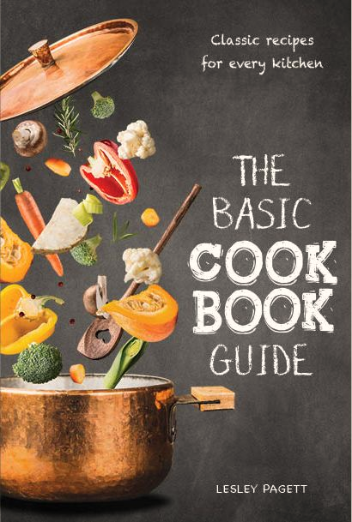
Cookbook Recipe App
A modern and elegant approach to recipe management for cooking enthusiasts.

Slide 3
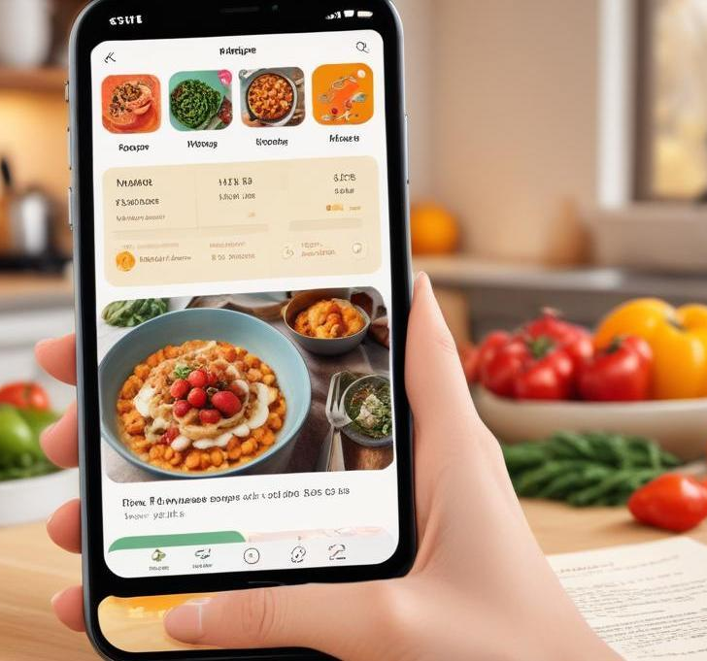
Introduction
This presentation covers the Cookbook Recipe App, designed to provide an organized platform for cooking enthusiasts. The app simplifies the cooking process by categorizing recipes, providing ingredient lists, and tutorial videos, ensuring that anyone can create delicious meals.

Slide 4
App purpose
The Cookbook Recipe App addresses the common struggle of finding and organizing recipes efficiently. It serves as a comprehensive cooking guide, enabling users to easily search for recipes, access detailed instructions, and utilize multimedia resources to enhance their cooking experience.

Slide 5

Key functionalities
The Cookbook Recipe App boasts several key functionalities, including categorized recipes for various cuisines, an extensive ingredients list for each recipe, embedded YouTube video tutorials for visual learning, and a user-friendly interface that allows easy navigation between different sections of the app.

Slide 6
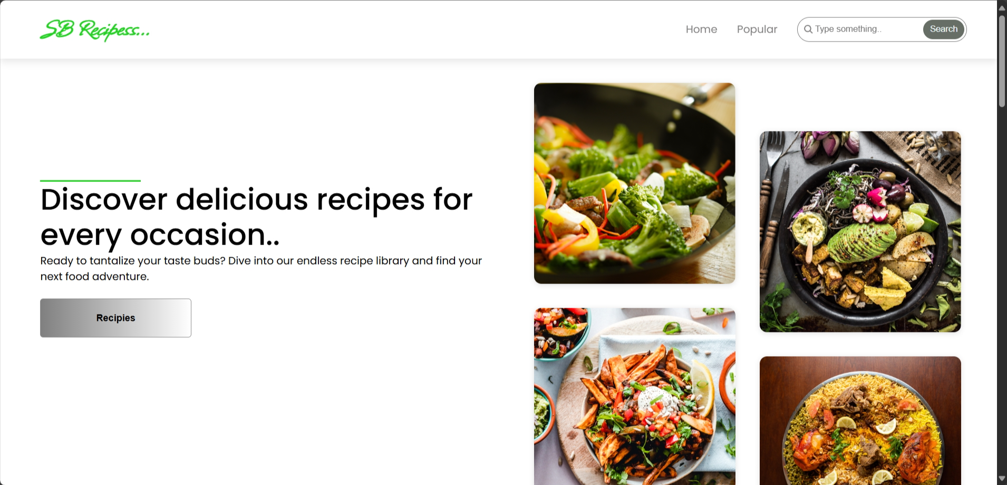
Dashboard

Slide 7
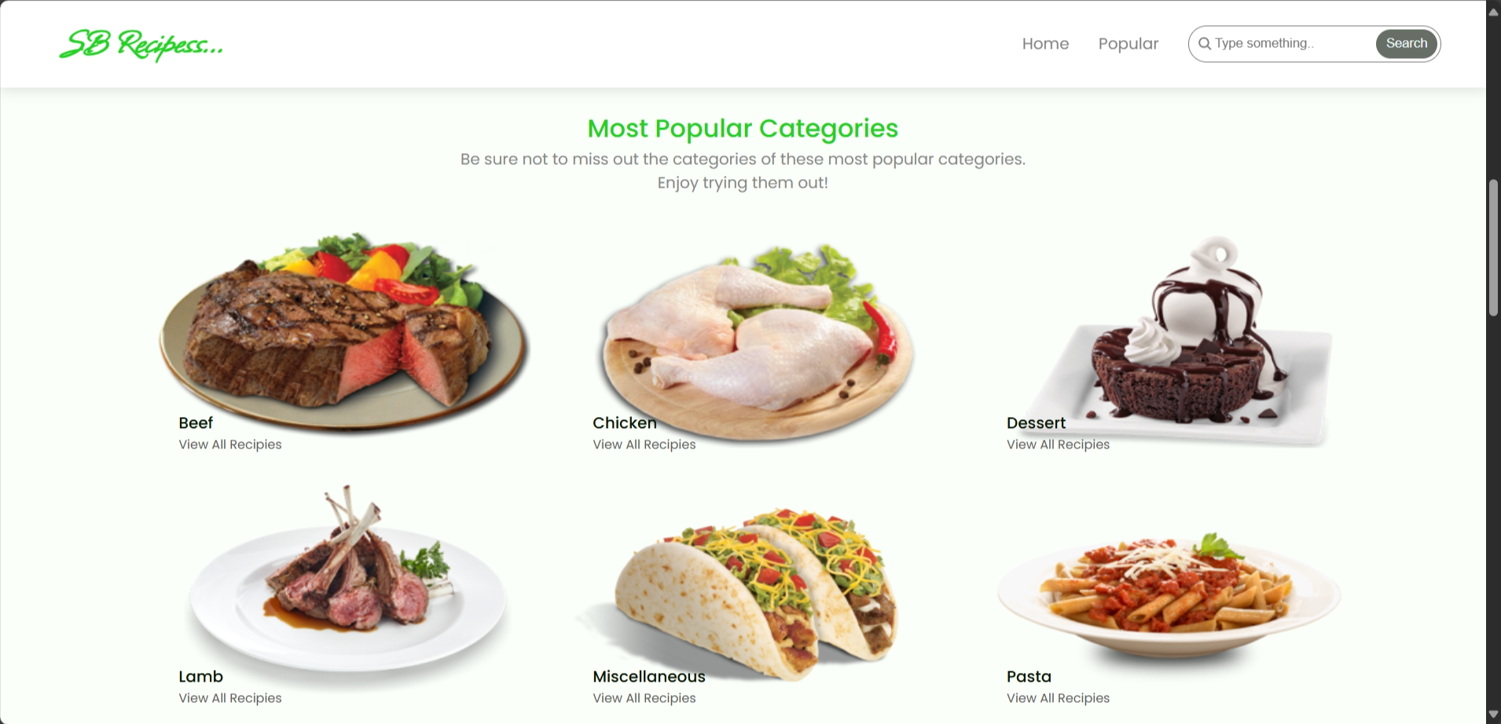
Categories

Slide 8
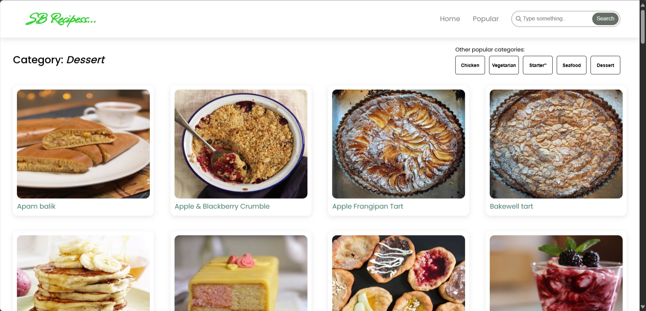
Dishes

Slide 9
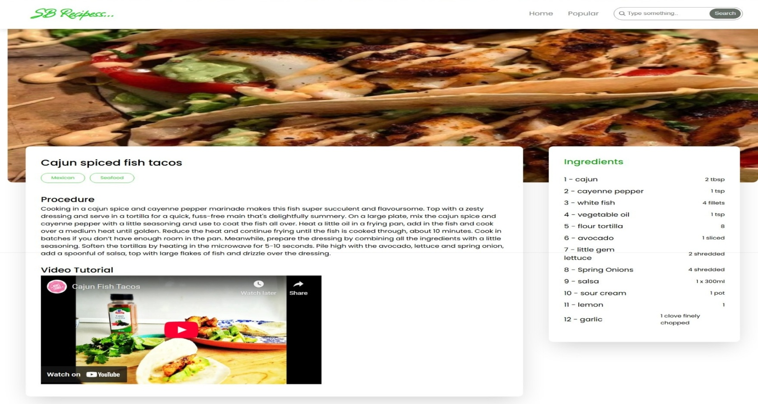
Recipe

Slide 10
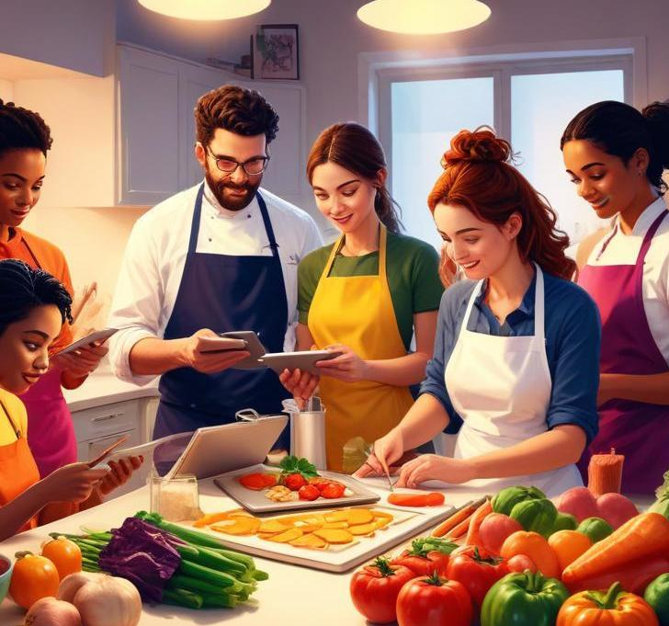
Target audience
This app targets home cooks, culinary students, and food enthusiasts who wish to explore new recipes and improve their cooking skills. It caters to a diverse audience, from beginners seeking guidance to experienced chefs looking for innovative recipes.

Slide 11
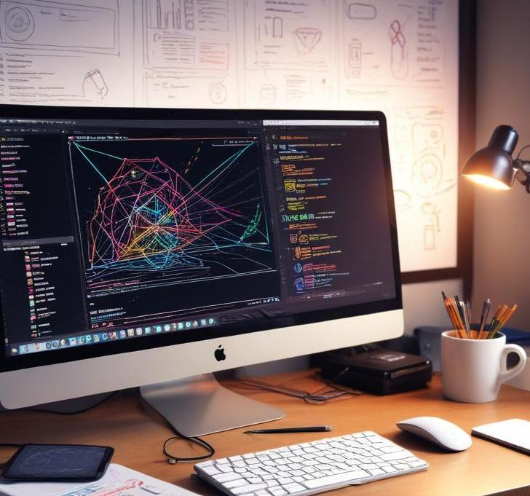
Front-end tech stack
The app is primarily built using React.js for its frontend, providing a dynamic and responsive user experience. It leverages modern JavaScript features, CSS for styling, and additional libraries to manage state and enhance user interactions effectively.

Slide 12

API Integrations
The Cookbook Recipe App utilizes the YouTube API, to incorporate video tutorials directly within the app. This integration enhances the user experience by offering seamless access to cooking demonstrations, making it easier for users to follow along.

Slide 13
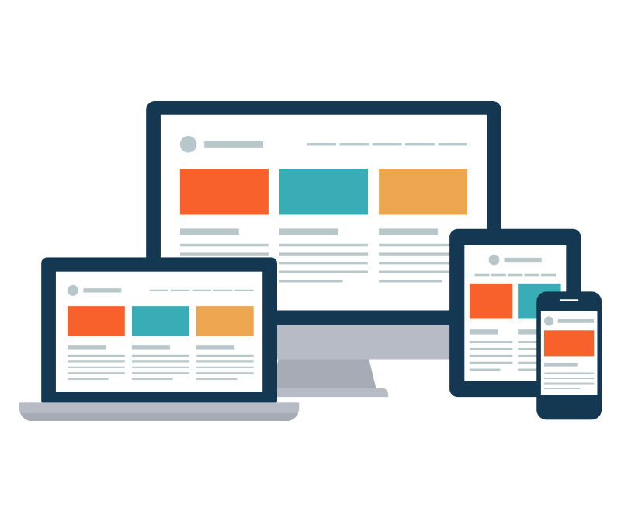
Responsive design
The app is designed to be fully responsive, ensuring that users can access it seamlessly across multiple devices including mobile phones, tablets, and desktops. This design approach guarantees an optimal viewing experience, allowing users to cook easily from any location.

Slide 14
PROJECT
Source Code - C:\Users\arunn\OneDrive\Desktop\Recipe
Live Project - http://localhost:3000

Slide 15
Conclusions
In conclusion, the Cookbook Recipe App effectively merges an elegant design with powerful functionalities, making it an invaluable tool for anyone passionate about cooking. Its use of modern technology and responsive design enhances user engagement, ensuring a seamless experience for all cooking enthusiasts.

Slide 16
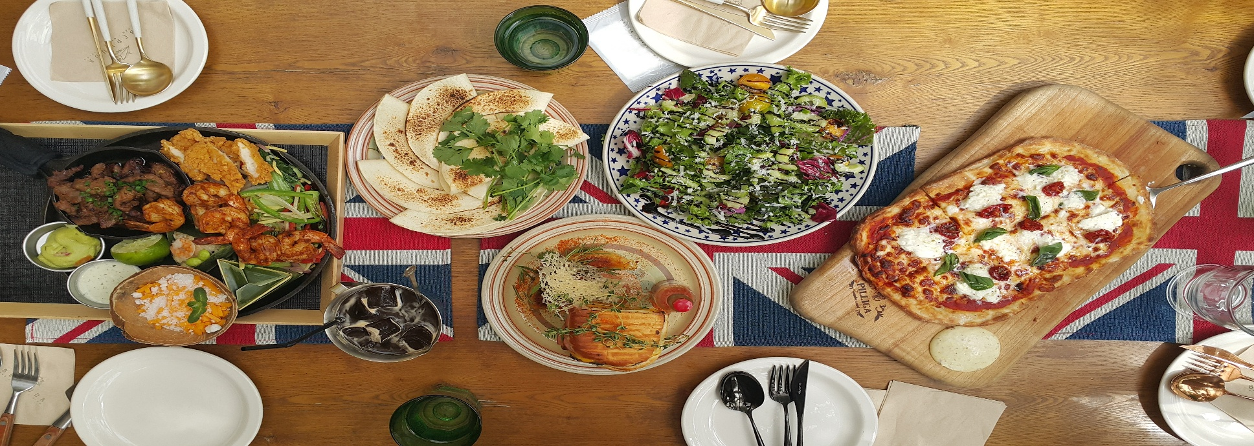
Thank you!
Do you have any questions?

